Slide 1
The microbiome of Amerindians living in subsistence economies with different exposure to medicine
Jincheng Wang, Dan Scot Kyle Bittinger, Haipeng Sun, Oscar Noya, Monica Contreras, Noel Mueller, Orlana Lander, Mariapia Bevilaqua, , Kyle Bittinger, Maria G Dominguez-Bello
Environmental factors (diet, chemical exposures, infections, human microbiome) are sources of human variation in grown, body morphometry and metabolism. Urbanization changes all of these factors, and is leading to taller and fatter humans, with lower microbiome diversity. To examine how body morphometry and gut microbiomes differ among human populations with similar ethnic background, and lifestyle, but different exposure to antimicrobials and medicines, we characterized body morphometry and fecal bacterial structure and gene content in xxx healthy Amerindian children and adults. Subjects were villagers from 5 jungle communities from Bolivar State in Southern Venezuela, from 2 ethnic groups, eith high or low exposure to medication (mostly antibiotics, antiparasites, analgesic and vaccines)
1- Body morphometry (HAZ in infants, BMI in adults by gender)
2-Microbiome:
2.1-Functional maturation of the gut microbiome in the first years of life (3? 8?)
2.2-Age-associated changes in the genes involved in vitamin biosynthesis and metabolism?
2.3-Differences in bacterial assemblages and functional gene repertoires in children and in adults
Our results evidence that the use of medicines, which typically initiates transculturation of traditional villagers, initiates the changes in the microbiome and human development associated with urbanization.

Slide 2
Table 1 Number of subjects sampled in different villages by year
Exposure Level | Village | N inhabitants | Ethnicity | 2015 |  |  |  |  | 2016
 |  |  |  | Age_0-3 | Age_3-8 | Age_8-18 | Adults | Total | Age_0-3 | Age_3-8 | Age_8-18 | Adults | Total
Low | Chajuranha |  | Sanema | 2 | 6 | 2 | 5 | 15 | 2 | 7 | 2 | 6 | 17
 | Kuyuwininha |  | Sanema | 1 | 8 | 5 | 16 | 30 | - | 10 | 6 | 22 | 38
 | Mosenahanha |  | Sanema | 4 | 3 | 4 | 4 | 15 | - | - | - | - | -
 | Shianana-Jiyakwanha |  | Sanema | 2 | 4 | 8 | 13 | 27 | 3 | 5 | 4 | 9 | 21
 | Sudukuma |  | Sanema | - | - | - | - | - | 4 | 6 | 6 | 8 | 24
 | Washudihanha |  | Sanema | 4 | 10 | 5 | 12 | 31 | 3 | 4 | 2 | 5 | 14
 | Fiyakwanha |  | Yekwana | - | - | - | - | - | 6 | 6 | 14 | 21 | 47
 | Subtotal |  |  | 13 | 31 | 24 | 50 | 118 | 18 | 38 | 34 | 71 | 161
Medium | Kanarakuni |  | Yekwana | 22 | 15 | 17 | 25 | 79 | 14 | 15 | 18 | 27 | 74
 | Subtotal |  |  | 22 | 15 | 17 | 25 | 79 | 14 | 15 | 18 | 27 | 74
Total |  |  |  | 35 | 46 | 41 | 75 | 197 | 32 | 53 | 52 | 98 | 235

Slide 3
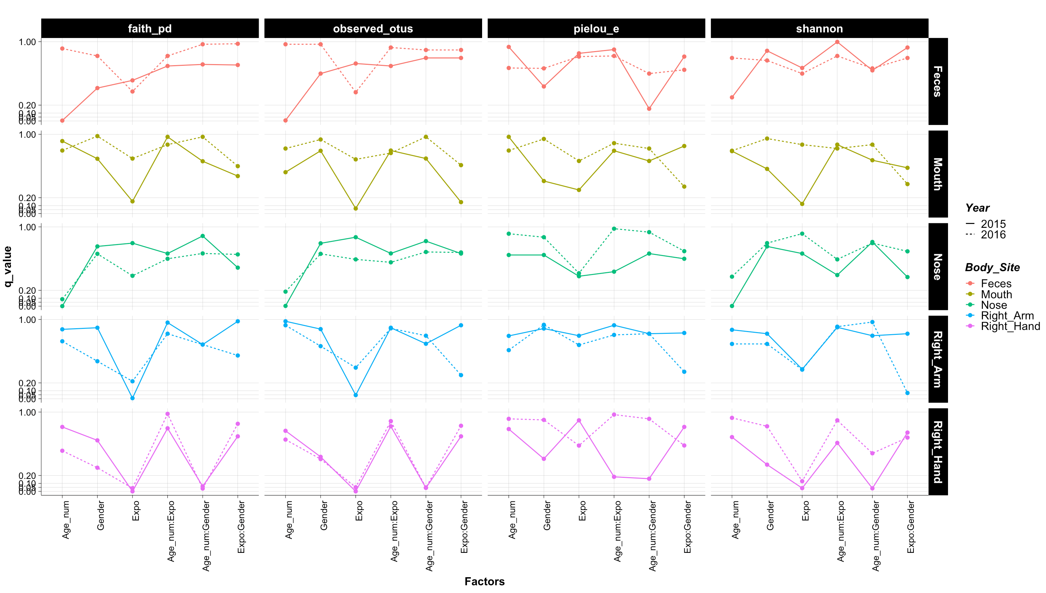
FDR corrected p-value using a full multiple regression models for alpha diversity in CHILDREN
Interaction terms generally are not significant except for Right Hand, in which age:gender interactions seems to be consistent.
Expo are generally significant.

Slide 4
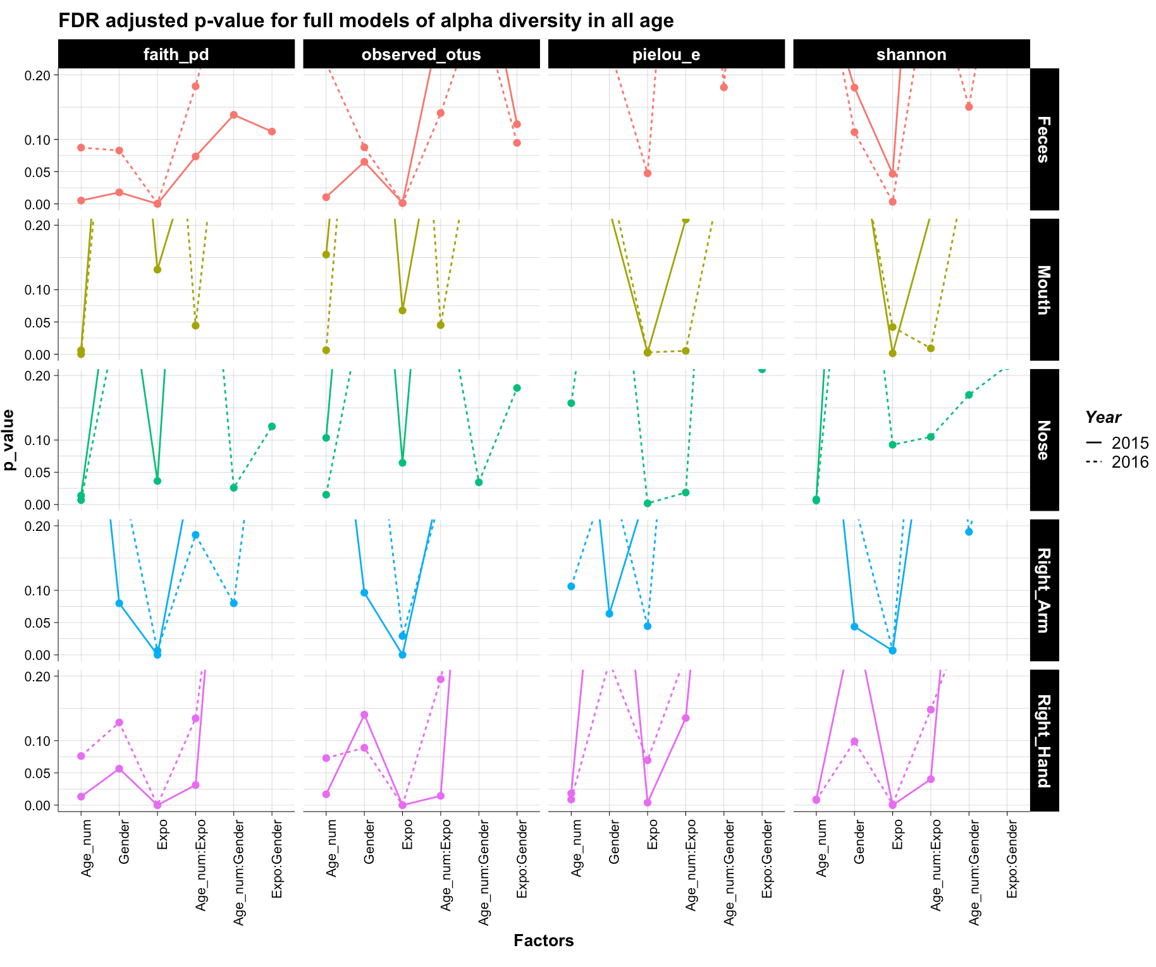
FDR corrected p-value using a full multiple regression models for alpha diversity in all above 1 year old
Interaction terms generally are not significant for Feces and Right_Arms. For Mouth and Right_Hand, Age:Expo interaction is significant for 2016; For Nose, Age:Gender interaction is significant for 2016,
Expo are generally significant; in all these three cases, the Age_num itself are all significant.
Expo is consistently significant among Feces, and Right Arms and Right Skins. For Nose, it is significant for 2015 for richness, but for 2016 for pielou_e

Slide 5
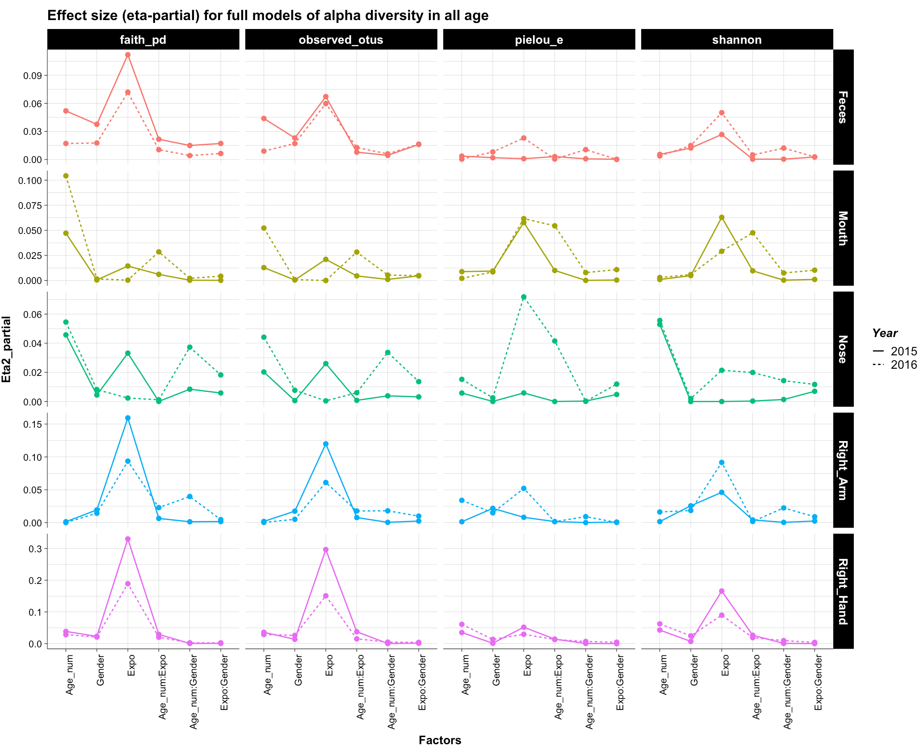
Effect size (eta-partial) using a full multiple regression models for alpha diversity in all above 1 year old
For 2015, interaction terms generally do not have big effect size in any tests.
For 2016, interaction terms generally only had big effect sizes in nasal sites.
As a result, interaction terms would not be considered in the general tests.

Slide 6
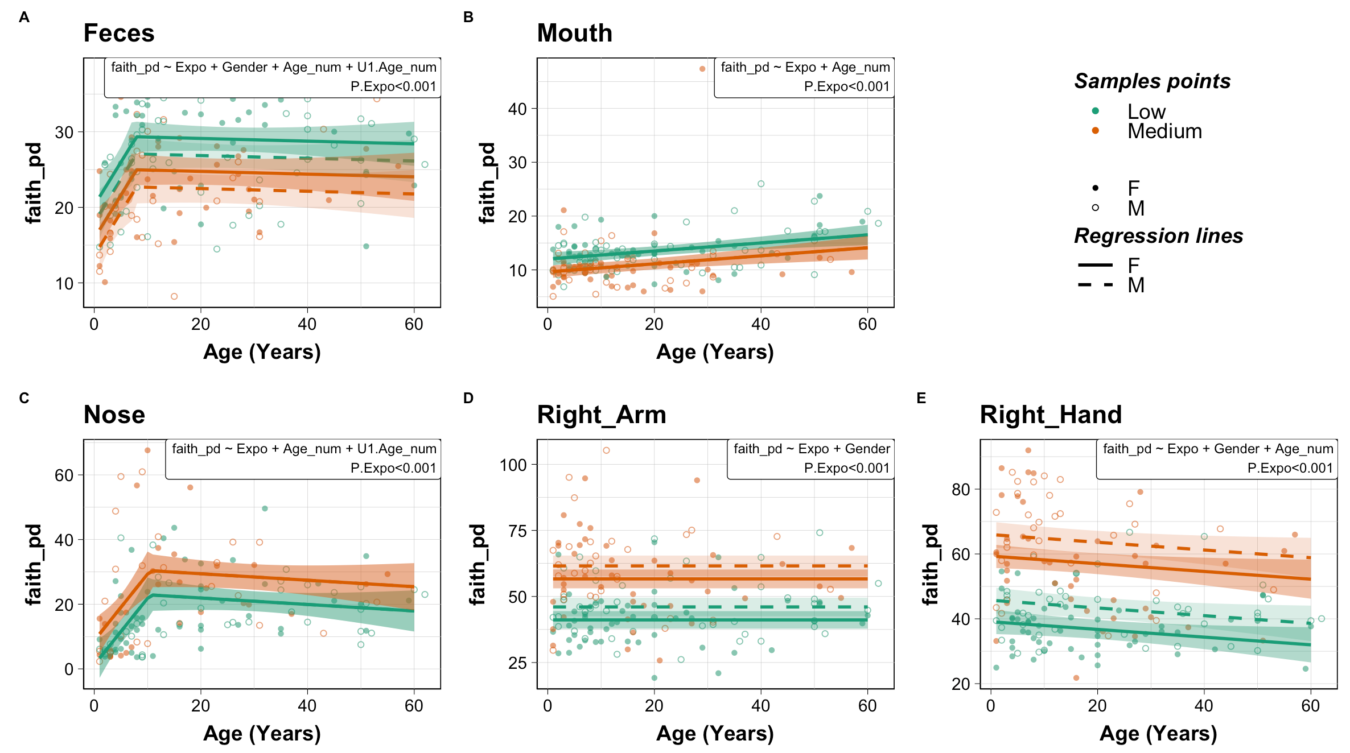
Figure 1 Microbiota alpha diversity (PD) from Amerindian villagers from low and medium medical exposure in 2015. (A) Feces, (B) Mouth, (C) Nose, (D) Right Arm, (E) Right Hand. Infants younger than 1 yr were not included. Impacts of medical exposure level, gender, age and their interactions on the alpha diversity indexes were examined by firstly constructing full multiple regression models. Since interaction terms generally do not have significant impacts, impacts of exposure, gender and age were further examined without interaction terms using a forward selection strategy with AIC as model selection criteria (MASS package stepAIC). Selected multiple regression model predictors were then used to construct a broken stick regression model to assess the age dependent differential effects on the alpha diversities (segmented package) if the broken stick model is significantly better than simple linear regression. The final model (linear or broken stick) and the the p-values of exposure were noted in the graph. See table Sx for details.
2015
Exposure level significantly impacted the the alpha diversity (Faith’s PD). Exposure level has the strongest effect comparing to other factors (judged by coefficient estimate and t-value).
Age is a significant factor in all body sites but right arm, and the direction and pattern of its impact vary by different body sites.
The age-dependent pattern in feces and nose appeared to be a two-phase pattern.
Gender is a significant factor except in mouth and nose.
In fecal and oral community, medical exposure resulting in less alpha diversity, however, in nasal and skin community, medical exposure was associated with much higher alpha diversity.

Slide 7
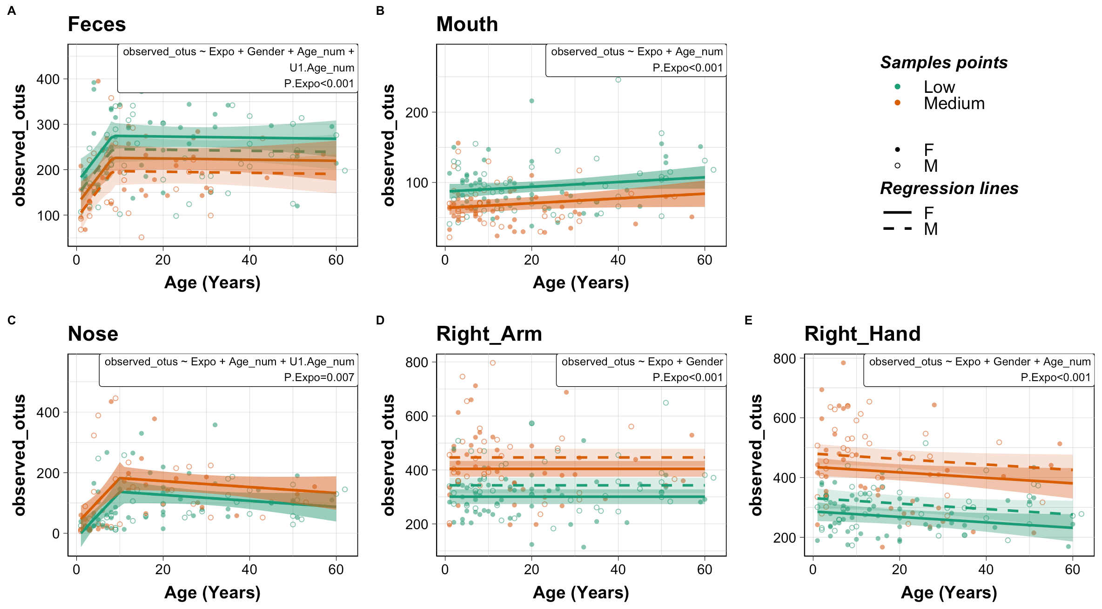
Figure S1 Microbiota alpha diversity (ASV richness) from Amerindian villagers from low and medium urban exposure in 2015. (A) Feces, (B) Mouth, (C) Nose, (D) Right Arm, (E) Right Hand. Infants younger than 1 yr were not included. Impacts of medical exposure level, gender, age and their interactions on the alpha diversity indexes were examined by firstly constructing full multiple regression models. Since interaction terms generally do not have significant impacts, impacts of exposure, gender and age were further examined without interaction terms using a forward selection strategy with AIC as model selection criteria (MASS package stepAIC). Selected multiple regression model predictors were then used to construct a broken stick regression model to assess the age dependent differential effects on the alpha diversities (segmented package) if the broken stick model is significantly better than simple linear regression. The final model (linear or broken stick) and the the p-values of exposure were noted in the graph. See table Sx for details.
2015
Similar trends as in Faith’s PD
The medium exposure village have 100-150 more ASVs in skin as compared to low exposure villages.
In feces, medium villages have 50.ASV less than low villages

Slide 8
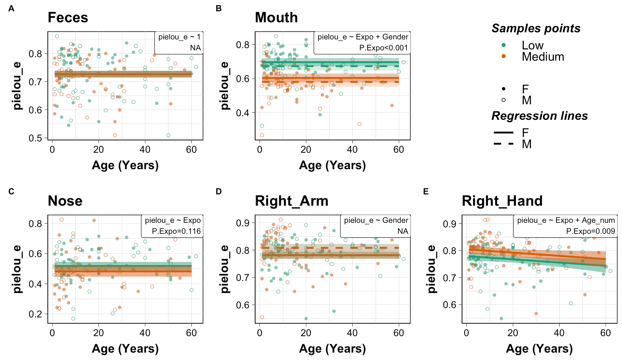
Figure S2 Microbiota alpha diversity (Pielou’s evenness) from Amerindian villagers from low and medium urban exposure in 2015. (A) Feces, (B) Mouth, (C) Nose, (D) Right Arm, (E) Right Hand. Infants younger than 1 yr were not included. Impacts of level of medical exposure, gender, age and their interactions on the alpha diversity indexes were examined by firstly constructing multiple Infants younger than 1 yr were not included. Impacts of urban level, gender, age and their interactions on the alpha diversity indexes were examined by firstly constructing multiple regression models with a forward selection using AIC as model selection criteria (MASS package stepAIC). Selected multiple regression model predictors were then used to construct a broken stick regression model using urban, age, and gender as predictive variable (segmented package) if the broken stick model is significantly better than simple linear regression. The numbers in each panel indicate the p-values of exposure after multiple linear regression. There was a significant effect of age in fecal microbiota, and of gender in fecal and skin (right arm and right hand) microbiota. See table Sx for details.
2015
Exposure is not significant in feces and right arm.

Slide 9
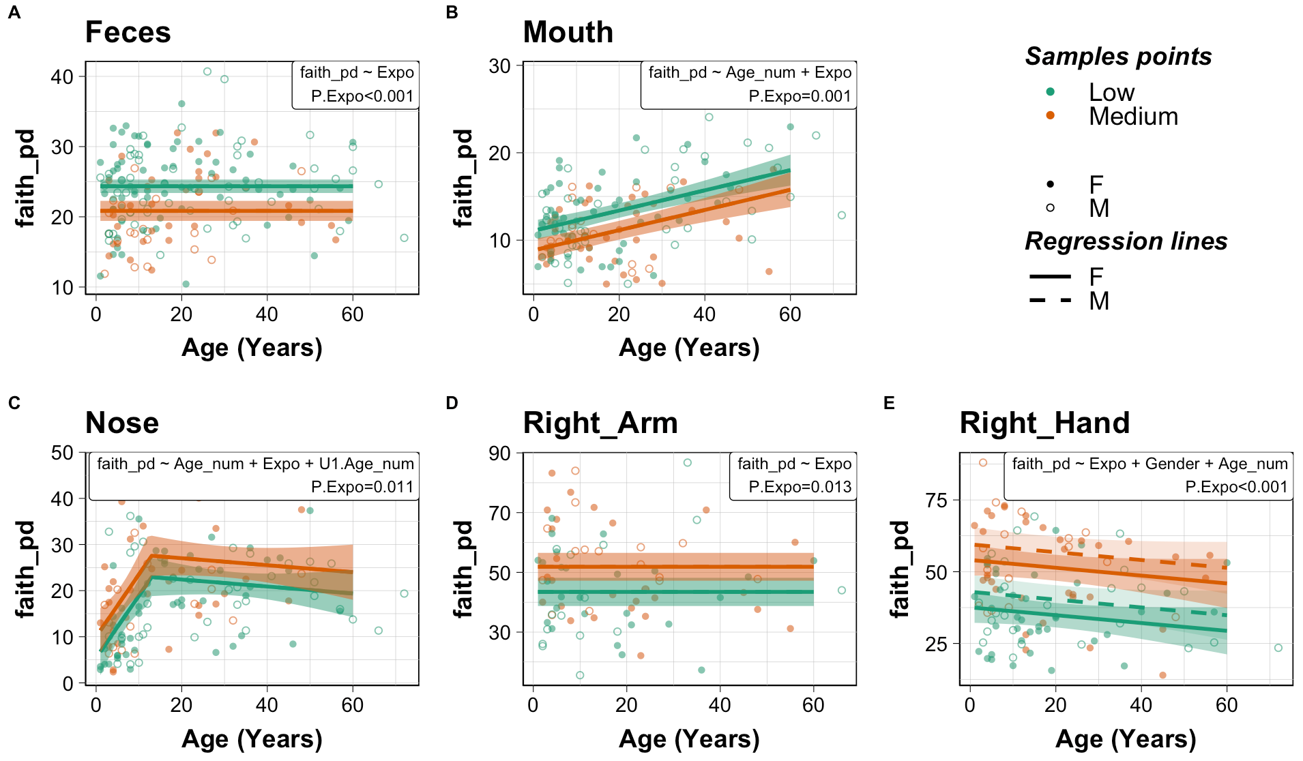
Figure Sx Microbiota alpha diversity (PD) from Amerindian villagers from low and medium urban exposure in 2016. (A) Feces, (B) Mouth, (C) Nose, (D) Right Arm, (E) Right Hand. Infants younger than 1 yr were not included. Impacts of level of medical exposure, gender, age and their interactions on the alpha diversity indexes were examined by firstly constructing multiple Infants younger than 1 yr were not included. Impacts of urban level, gender, age and their interactions on the alpha diversity indexes were examined by firstly constructing multiple regression models with a forward selection using AIC as model selection criteria (MASS package stepAIC). Selected multiple regression model predictors were then used to construct a broken stick regression model using urban, age, and gender as predictive variable (segmented package) if the broken stick model is significantly better than simple linear regression. The numbers in each panel indicate the p-values of exposure after multiple linear regression. There was a significant effect of age in fecal microbiota, and of gender in fecal and skin (right arm and right hand) microbiota. See table Sx for details.
2016
Exposure is not significant in feces and right arm.
Similarly as in 2015, the effects of exposure is significant in all body sites.
Interestingly in 2016, the age dependent trend in fecal microbiome become unobservable.

Slide 10
Table S1. Statistics for linear regression models examining effects of exposure, age, and gender on alpha diversities in multiple body sites. The regression coefficient, p value, and effect size as measured by partial omega2 are presented for significant variables.
Variables | Body_Site | Year | faith_pd |  |  | ASV richness |  |  | pielou_e |  |  | shannon
 |  |  | Coefficient | p value | Effect size: Omega2_paritial(95% CI) | Coefficient | p value | Effect size: Omega2_paritial(95% CI) | Coefficient | p value | Effect size: Omega2_paritial(95% CI) | Coefficient | p value | Effect size: Omega2_paritial(95% CI)
Exposure | Feces | 2015 | -4.37 | <0.001 | 0.118(0.038, 0.22) | -48.45 | <0.001 | 0.082(0.017, 0.176) |  |  |  | -0.416 | 0.002 | 0.053(0.006, 0.137)
Medical Exposure | Feces | 2016 | -3.51 | <0.001 | 0.079(0.02, 0.165) | -30.2 | 0.002 | 0.048(0.006, 0.123) | -0.036 | 0.002 | 0.046(0.005, 0.121) | -0.44 | <0.001 | 0.068(0.014, 0.15)
Medical Exposure | Mouth | 2015 | -2.38 | <0.001 | 0.063(0.01, 0.147) | -23.33 | <0.001 | 0.082(0.019, 0.172) | -0.092 | <0.001 | 0.183(0.088, 0.288) | -0.875 | <0.001 | 0.204(0.105, 0.309)
Medical Exposure | Mouth | 2016 | -2.25 | 0.001 | 0.062(0.008, 0.151) | -17.56 | 0.009 | 0.039(0.001, 0.118)
Medical Exposure | Nose | 2015 | 7.5 | <0.001 | 0.074(0.011, 0.172) | 45.54 | 0.007 | 0.046(0.002, 0.133) | -0.035 | 0.116 | 0.011(0, 0.07)
Medical Exposure | Nose | 2016 | 4.62 | 0.011 | 0.039(0, 0.122) |  |  |  | -0.037 | 0.08 | 0.015(0, 0.079)
Medical Exposure | Right_Arm | 2015 | 15.52 | <0.001 | 0.248(0.142, 0.354) | 103.27 | <0.001 | 0.176(0.082, 0.28) |  |  |  | 0.422 | <0.001 | 0.063(0.01, 0.148)
Medical Exposure | Right_Arm | 2016 | 8.41 | 0.013 | 0.061(0, 0.184) | 55.03 | 0.076 | 0.026(0, 0.128) | 0.046 | <0.001 | 0.12(0.02, 0.261) | 0.599 | <0.001 | 0.126(0.022, 0.268)
Medical Exposure | Right_Hand | 2015 | 20.25 | <0.001 | 0.408(0.297, 0.505) | 149.14 | <0.001 | 0.342(0.23, 0.445) | 0.025 | 0.009 | 0.035(0.001, 0.107) | 0.665 | <0.001 | 0.176(0.082, 0.281)
Medical Exposure | Right_Hand | 2016 | 16.52 | <0.001 | 0.231(0.108, 0.356) | 135.03 | <0.001 | 0.185(0.073, 0.31) |  |  |  | 0.666 | 0.001 | 0.08(0.011, 0.189)
Age | Feces | 2015 | 1.15 | 0.006 | 0.041(0.002, 0.121) | 12.48 | 0.004 | 0.046(0.003, 0.128)
Age | Feces | 2016
Age | Mouth | 2015 | 0.07 | <0.001 | 0.062(0.01, 0.147) | 0.34 | 0.072 | 0.014(0, 0.069)
Age | Mouth | 2016 | 0.12 | <0.001 | 0.177(0.078, 0.287) | 0.81 | <0.001 | 0.098(0.026, 0.198) |  |  |  | 0.01 | 0.047 | 0.02(0, 0.086)
Age | Nose | 2015 | 2.06 | <0.001 | 0.08(0.014, 0.18) | 15.13 | <0.001 | 0.075(0.012, 0.173) |  |  |  | 0.147 | 0.004 | 0.052(0.004, 0.141)
Age | Nose | 2016 | 1.35 | <0.001 | 0.08(0.014, 0.179) | 8.15 | <0.001 | 0.075(0.012, 0.172) |  |  |  | 0.096 | 0.001 | 0.069(0.01, 0.165)
Age | Right_Arm | 2015
Age | Right_Arm | 2016 |  |  |  |  |  |  | -0.001 | 0.043 | 0.037(0, 0.149) | -0.009 | 0.104 | 0.02(0, 0.116)
Age | Right_Hand | 2015 | -0.12 | 0.043 | 0.019(0, 0.08) | -0.91 | 0.066 | 0.015(0, 0.071) | -0.001 | 0.04 | 0.02(0, 0.081) | -0.008 | 0.028 | 0.023(0, 0.087)
Age | Right_Hand | 2016 | -0.14 | 0.117 | 0.013(0, 0.081) | -1.33 | 0.102 | 0.015(0, 0.086) | -0.003 | 0.001 | 0.078(0.01, 0.186) | -0.016 | 0.013 | 0.044(0, 0.138)
Age_break | Feces | 2015 | -1.17 | NA | 0.043(0.002, 0.123) | -12.61 | NA | 0.047(0.003, 0.129)
Age_break | Feces | 2016
Age_break | Mouth | 2015
Age_break | Mouth | 2016
Age_break | Nose | 2015 | -2.16 | NA | 0.086(0.017, 0.188) | -16.12 | NA | 0.083(0.016, 0.184) |  |  |  | -0.155 | NA | 0.056(0.005, 0.147)
Age_break | Nose | 2016 | -1.43 | NA | 0.086(0.017, 0.187) | -8.88 | NA | 0.083(0.016, 0.183) |  |  |  | -0.113 | NA | 0.085(0.017, 0.185)
Age_break | Right_Arm | 2015
Age_break | Right_Arm | 2016
Age_break | Right_Hand | 2015
Age_break | Right_Hand | 2016 |  |  |  |  |  |  | 0.009 |  | 0.026(0, 0.109)
Gender | Feces | 2015 | 2.27 | 0.014 | 0.033(0, 0.107) | 29.09 | 0.019 | 0.029(0, 0.101) |  |  |  | 0.252 | 0.057 | 0.017(0, 0.078)
Gender | Feces | 2016
Gender | Mouth | 2015 |  |  |  |  |  |  | 0.024 | 0.117 | 0.009(0, 0.059)
Gender | Mouth | 2016
Gender | Nose | 2015
Gender | Nose | 2016
Gender | Right_Arm | 2015 | -4.92 | 0.02 | 0.027(0, 0.094) | -42.17 | 0.015 | 0.03(0, 0.099) | -0.027 | 0.006 | 0.039(0.002, 0.113) | -0.364 | 0.003 | 0.047(0.004, 0.125)
Gender | Right_Arm | 2016
Gender | Right_Hand | 2015 | -6.62 | <0.001 | 0.065(0.011, 0.151) | -44.57 | 0.006 | 0.04(0.002, 0.115) |  |  |  | -0.252 | 0.023 | 0.025(0, 0.091)
Gender | Right_Hand | 2016 | -5.43 | 0.057 | 0.023(0, 0.102) | -50.57 | 0.058 | 0.022(0, 0.102) |  |  |  | -0.307 | 0.136 | 0.011(0, 0.077)
Medical exposure consistently has the strongest effects among all factors, across all body sites, in both years for faith_pd and ASV richness. The effect size for medical exposure for both faith_pd and ASV generally had medium effects in fecal, oral and nasal microbiome (omega2 in 0.06-0.14) , and large effect in skin microbiome (>0.14)
In fecal and oral microbiota, more exposure resulting in less alpha diversity, however, in nasal and skin microbiota, more exposure was associated with higher alpha diversity. In skin, more medical exposure was associated with as much as 149 more ASV.
Age had consistently large effect on fecal and nasal microbiota, especially during the younger age.
Interestingly, male villagers had consistently higher alpha diversity in hand microbiome than females, although the effects are only small to medium.

Slide 11
Figure 2 Microbiota alpha diversity (PD) in Amerindian villagers from low medical exposure before (2015) and after (2016) quarterly ivermectin administration . (A) Feces, (B) Mouth, (C) Nose, (D) Right Arm, (E) Right Hand. Infants younger than 1 yr were not included. Impacts of medical exposure level, gender, age and their interactions on the alpha diversity indexes were examined by firstly constructing full multiple regression models. Since interaction terms generally do not have significant impacts, impacts of exposure, gender and age were further examined without interaction terms using a forward selection strategy with AIC as model selection criteria (MASS package stepAIC). Selected multiple regression model predictors were then used to construct a broken stick regression model to assess the age dependent differential effects on the alpha diversities (segmented package) if the broken stick model is significantly better than simple linear regression. The final model (linear or broken stick) and the the p-values of exposure were noted in the graph.
Only fecal microbiota showed significant reduced faith pd comparing 2016 and 2015.
The effect of age and gender is similar to previous analysis.

Slide 12
Figure S3 Microbiota alpha diversity (Pielou’s evenness) in Amerindian villagers from low medical exposure before (2015) and after (2016) quarterly ivermectin administration . (A) Feces, (B) Mouth, (C) Nose, (D) Right Arm, (E) Right Hand. Infants younger than 1 yr were not included. Impacts of medical exposure level, gender, age and their interactions on the alpha diversity indexes were examined by firstly constructing full multiple regression models. Since interaction terms generally do not have significant impacts, impacts of exposure, gender and age were further examined without interaction terms using a forward selection strategy with AIC as model selection criteria (MASS package stepAIC). Selected multiple regression model predictors were then used to construct a broken stick regression model to assess the age dependent differential effects on the alpha diversities (segmented package) if the broken stick model is significantly better than simple linear regression. The final model (linear or broken stick) and the the p-values of exposure were noted in the graph.
Only oral microbiota showed significant reduced evenness comparing 2016 and 2015.

Slide 13
Table S2. Comparing alpha diversity from low medical exposure villages in 2016 to 2015. The regression coefficient adjusted for gender and age, p value, and effect size as measured by partial omega2 are presented only if significant.
Factor | Body_Site | faith_pd |  |  | ASV richness |  |  | pielou_e |  |  | shannon
Factor | Body_Site | Coefficient | p value | Effect size: Omega2_paritial(95% CI) | Coefficient | p value | Effect size: Omega2_paritial(95% CI) | Coefficient | p value | Effect size: Omega2_paritial(95% CI) | Coefficient | p value | Effect size: Omega2_paritial(95% CI)
Year | Feces | -2.6 | 0.001 | 0.044(0.006, 0.11) | -40.1 | <0.001 | 0.072(0.019, 0.147) |  |  |  | -0.211 | 0.044 | 0.014(0, 0.061)
YearC | Mouth |  |  |  |  |  |  | -0.067 | <0.001 | 0.107(0.037, 0.196) | -0.461 | <0.001 | 0.061(0.011, 0.139)
YearC | Nose
YearC | Right_Arm
YearC | Right_Hand |  |  |  |  |  |  |  |  |  | -0.218 | 0.111 | 0.01(0, 0.063)
Comparing 2016 and 2015, there is significant lower alpha diversity in feces in all index but evenness. The effect size based on richness is medium.
In oral microbiota, there is also significantly lower alpha diversity, but only in index based on abundance, the effect is medium.
In nasal, and skin community, there appeared to be no significant year effect.

Slide 14
Table SX. Alpha diversity comparing year 2016 to 2015, among different exposure and age groups. Percent difference comparing 2016 to 2015 and adjusted p value (fdr adjustment) from Wilcoxon test (in parentheses) are shown. Comparison with adjusted p value <=0.1 are highlighted in red. Comparisons in which 2016 had a higher alpha diversity are shaded in blue, and 2016 had a lower alpha diversity are in orange.
Alpha diversity | Body Site | Low Exposure |  |  |  | Medium Exposure
 |  | Age_0-3 | Age_3-8 | Age_8-18 | Adults | Age_0-3 | Age_3-8 | Age_8-18 | Adults
faith_pd | Feces | 2.78%(1) | -9.28%(0.283) | -17.84%(0.009) | -6.95%(0.182) | 5.63%(0.829) | -18.84%(0.182) | -16.5%(0.232) | -1.76%(0.912)
 | Mouth | -6.89%(0.673) | -6.87%(0.595) | -9.19%(0.557) | 7.24%(0.595) | -23.85%(0.557) | 0.66%(0.673) | 15.16%(0.557) | -3.49%(0.62)
 | Nose | 53.95%(0.817) | -17.51%(0.662) | 16.66%(0.662) | 1.08%(0.817) | 100.38%(0.076) | -28.93%(0.817) | -25.28%(0.662) | -4.67%(0.817)
 | Right_Arm | -16.05%(0.598) | 20.1%(0.17) | -3.24%(0.91) | -4.71%(0.824) | 0.94%(0.968) | -21.46%(0.17) | 1.31%(0.852) | -16.99%(0.17)
 | Right_Hand | -24.3%(0.395) | 3.81%(0.718) | -13.15%(0.135) | -4.73%(0.653) | 4.68%(0.718) | -26.76%(0.003) | -7.58%(0.718) | -7.92%(0.653)
ASV richness | Feces | 5.67%(0.765) | -10.15%(0.61) | -27.3%(0.012) | -16.05%(0.048) | 13.01%(0.765) | -29.2%(0.132) | -23.24%(0.212) | -0.71%(0.972)
 | Mouth | -12.55%(0.546) | -7.4%(0.546) | -7.44%(0.546) | 10.97%(0.546) | -19.24%(0.546) | 7.09%(0.546) | 31.47%(0.546) | 4.83%(0.546)
 | Nose | 94.07%(0.921) | -28.13%(0.541) | 11.66%(0.921) | -5.68%(0.921) | 169.31%(0.046) | -46%(0.921) | -40.46%(0.541) | -2.58%(0.921)
 | Right_Arm | -9.49%(0.624) | 28.08%(0.432) | -8.27%(0.624) | -1.46%(0.624) | 10.37%(0.624) | -21.77%(0.432) | 3.19%(0.763) | -12.15%(0.592)
 | Right_Hand | -17.69%(0.504) | 9%(0.784) | -10.57%(0.288) | -5.2%(0.69) | 13.23%(0.69) | -25.64%(0.018) | -4.43%(0.784) | -1.12%(0.784)
pielou_e | Feces | 1.29%(0.964) | -2.11%(0.52) | -2.1%(0.706) | 0.6%(0.964) | 1.21%(0.964) | -9.06%(0.478) | -6.14%(0.52) | 0.22%(0.964)
 | Mouth | -3.65%(0.182) | -17.1%(0.008) | -12.06%(0.022) | -5.73%(0.023) | 2.24%(0.921) | 6.49%(0.461) | 18.63%(0.002) | 3.15%(0.347)
 | Nose | 10.34%(0.672) | -0.38%(0.874) | 5.23%(0.713) | -5.19%(0.381) | 3.99%(0.713) | -14.42%(0.713) | -12.87%(0.381) | 13.83%(0.381)
 | Right_Arm | -3%(0.918) | 4.29%(0.486) | -1.39%(0.918) | -4.48%(0.486) | 4.59%(0.712) | 0.19%(0.918) | 4.44%(0.486) | 3.15%(0.486)
 | Right_Hand | -0.1%(1) | 0.89%(0.912) | -1.49%(0.912) | -4.17%(0.912) | 3.21%(0.912) | -3.68%(0.445) | -1.86%(0.912) | -3.82%(1)
shannon | Feces | 1.76%(0.887) | -4.03%(0.44) | -7.33%(0.121) | -2.57%(0.48) | 3.62%(0.887) | -14.48%(0.08) | -10.35%(0.121) | 0.33%(0.887)
 | Mouth | -7.34%(0.4) | -19.26%(0.085) | -13.91%(0.104) | -4.42%(0.516) | -2.28%(0.842) | 8.14%(0.64) | 27.74%(0.02) | 4.67%(0.516)
 | Nose | 13.75%(0.955) | -7.41%(0.687) | 10.35%(0.701) | -5.58%(0.687) | 45.26%(0.076) | -23.42%(0.687) | -20.88%(0.687) | 12.57%(0.687)
 | Right_Arm | -5.11%(0.693) | 8.15%(0.35) | -4.33%(0.693) | -5.92%(0.566) | 6.18%(0.566) | -4.77%(0.566) | 4.5%(0.566) | 0.75%(0.969)
 | Right_Hand | -4.37%(0.528) | 1.63%(0.528) | -4.64%(0.528) | -5.95%(0.648) | 5.03%(0.566) | -8.63%(0.009) | -3.58%(0.919) | -4.03%(0.919)
The differences between years are not significant for most of the comparisons.
Fecal microbiome tended to have lower alpha diversity in 2016 for most age groups except infants and toddlers.
There appeared to be lower alpha diversity in 2016 in all body sites in most age groups using faith_pd and ASV richness except infants and toddlers
Did not consider sex

Slide 15
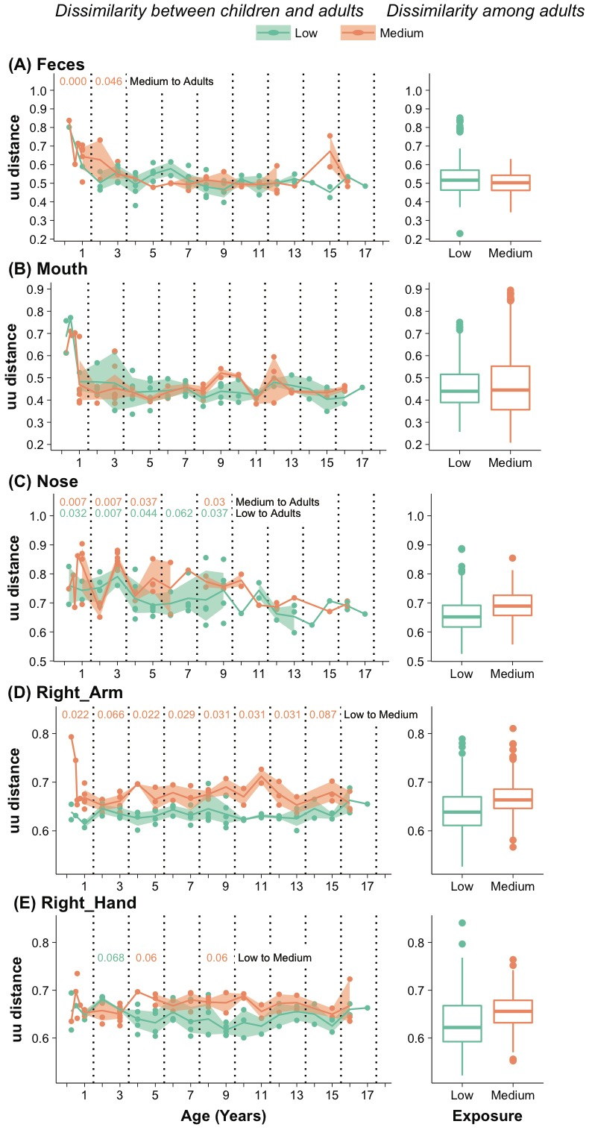
Figure S2. Dissimilarities of child-to-adult microbiota across different ages (left panels) compared with among-adult dissimilarities (right panels in 2015, stratified by exposure level. Each point on the left panels represents the average of unweighted unifrac distance between a child and all the adults in the same villages, with mean and 95% confidence interval plotted by exposure level. Kruskal-wallis tests were performed by pooling data from age 0-1, 2-3, 4-5, …, 16-17, to compare (1) child-to-adults dissimilarities between low and medium exposure level (Low to Medium) at each age interval; (2) children-to-adult dissimilarities to among-adult dissimilarities in low exposure villages (Low to Adults) at each age interval; (3) children-to-adult dissimilarities to among-adult dissimilarities in medium exposure villages (Medium to Adults) at each age interval. Multiple correction based on FDR was performed and a corrected p-value lower than 0.1 was deemed as significant and plotted on the graphs. The p-value was colored according to different exposure level with higher mean.
A decreasing trend of dissimilarities to adults with increasing age was only observed in the nasal microbiota, not in other body sites.
The dissimilarities to adults was higher for the medium than for the low exposure villagers in the skin, significant only for the right arm. They remain less adult-like, or immature.

Slide 16
Figure 2 Beta diversity differences in 16S microbial communities in villages with low and medium medical exposure in 2015 measured by unweighted unifrac distance. (A) Feces, (B) Mouth, (C) Nose, (D) Right Arm, (E) Right Hand.
Medical exposure consistently affects microbiota structure in nearly all ages and at all sites.

Slide 17
Table S2. Statistics for permanova test on marginal effect of urban and gender in separate age groups or across all age in each body sites in 2015. adonis2 function from vegan package was used to generate the statistics. Partial ω² >0.01 are highlighted with blue background (light to dark blue reflect small, medium and large effect size respectively) and bolded fonts. Adjusted p value (fdr adjustment) <0.10 are highlighted with red fonts and background.
Variable | Body Sites | Year | Unweighted Unifrac |  | Weighted Unifrac |  | Bray-Curtis
 |  |  | Partial ω² | p.adj | Partial ω² | p.adj | Partial ω² | p.adj
Exposure | Feces | 2015 | 0.023 | 0.002 | 0.021 | 0.006 | 0.015 | 0.002
Expo | Feces | 2016 | 0.018 | 0.002 | 0.008 | 0.04 | 0.013 | 0.002
Expo | Mouth | 2015 | 0.065 | 0.002 | 0.043 | 0.002 | 0.053 | 0.002
Expo | Mouth | 2016 | 0.034 | 0.002 | 0.017 | 0.017 | 0.011 | 0.006
Expo | Nose | 2015 | 0.026 | 0.002 | 0.021 | 0.026 | 0.03 | 0.002
Expo | Nose | 2016 | 0.012 | 0.002 | 0.018 | 0.012 | 0.02 | 0.002
Expo | Right_Arm | 2015 | 0.056 | 0.002 | 0.125 | 0.002 | 0.099 | 0.002
Expo | Right_Arm | 2016 | 0.03 | 0.002 | 0.053 | 0.002 | 0.045 | 0.002
Expo | Right_Hand | 2015 | 0.066 | 0.002 | 0.082 | 0.002 | 0.077 | 0.002
Expo | Right_Hand | 2016 | 0.045 | 0.002 | 0.041 | 0.002 | 0.03 | 0.002
Age | Feces | 2015 | 0.05 | 0.002 | 0.039 | 0.004 | 0.024 | 0.002
Age | Feces | 2016 | 0.033 | 0.002 | 0.033 | 0.002 | 0.021 | 0.002
Age | Mouth | 2015 | 0.031 | 0.002 | 0.042 | 0.002 | 0.049 | 0.002
Age | Mouth | 2016 | 0.068 | 0.002 | 0.068 | 0.002 | 0.045 | 0.002
Age | Nose | 2015 | 0.096 | 0.002 | 0.256 | 0.002 | 0.164 | 0.002
Age | Nose | 2016 | 0.071 | 0.002 | 0.219 | 0.002 | 0.163 | 0.002
Age | Right_Arm | 2015 | 0.005 | 0.009 | 0.046 | 0.002 | 0.017 | 0.002
Age | Right_Arm | 2016 | 0.007 | 0.026 | 0.023 | 0.005 | 0.016 | 0.002
Age | Right_Hand | 2015 | 0.008 | 0.004 | 0.03 | 0.004 | 0.024 | 0.002
Age | Right_Hand | 2016 | 0.009 | 0.009 | 0.026 | 0.005 | 0.022 | 0.002
Gender | Feces | 2015 | 0.002 | 0.151 | 0.005 | 0.106 | 0.002 | 0.151
Gender | Feces | 2016 | 0.004 | 0.03 | 0.007 | 0.063 | 0.002 | 0.083
Gender | Mouth | 2015 | 0 | 0.465 | -0.001 | 0.545 | 0 | 0.479
Gender | Mouth | 2016 | -0.001 | 0.627 | -0.007 | 1 | -0.002 | 0.888
Gender | Nose | 2015 | 0 | 0.48 | 0.003 | 0.239 | 0.012 | 0.019
Gender | Nose | 2016 | 0.001 | 0.214 | 0.006 | 0.137 | 0.004 | 0.118
Gender | Right_Arm | 2015 | 0.003 | 0.023 | 0.013 | 0.006 | 0.007 | 0.004
Gender | Right_Arm | 2016 | 0 | 0.4 | -0.001 | 0.545 | 0.004 | 0.044
Gender | Right_Hand | 2015 | 0.004 | 0.006 | 0.007 | 0.053 | 0.004 | 0.018
Gender | Right_Hand | 2016 | 0 | 0.448 | 0.008 | 0.044 | 0.003 | 0.029
Medical exposure is consistently significant in all body sites, in both years, having a small to medium effect size (0.01<=ω^{2 <}=0.14) across all body sites.
Age has a similar effect size as exposure, except for nasal microbiome (which is a much stronger effect size if using abundance-based index).
Gender in general has neglectable effects.

Slide 18
Fig 3. Relative Abundance of genera that are significantly different by medical exposure. (A) Feces, (B) Mouth, (C) Nose, (D) Right Arm, (E) Right Hand. Genera were identified by ANCOM log-ratio test; Ancom W statistics is presented as a side bar. The predicted log-ratio between medium and low exposure group of a significant changed genus were also presented as a side bar with positive values indicating higher in medium exposure group. Genera in the row are ordered by hierarchy clustering based on relative abundance in samples. ((Fig Sx with LEFSE ROSETA. Taxa aligned to legt margin for the heatmap) SEPARATE DISSAPEARING FROM INCREASING TAXA TREES
(A) Feces
Of 194 genera were identified from fecal microbiota in villagers in 2015; 20 genera were significantly different by exposure.
Changes based on references of the three families that are abundant and did not change in this work, Prevotellaceae, Succinivibrionaceae, and Spirochaetaceae
DECREASING TAXA: several Clostidiales (Lachnospiraceae, Ruminococcaceae), Mollicutes.RF39 genus, Dialister, Erysipelotrichaceae-UCG004 genus, Methanobrevibacter
INCREASING: Bacteroides, Parabacteroides, Haemophilus, Enterobacteriaceae, Odoribacter.
DISCUSSION: Prevotellaceae, Succinivibrionaceae, and Spirochaetaceae, which were previously suggested to be more abundant in Hadza populations (Smits 2017), were among the species that did not change with urban exposure; these species on average constitute of 31.5%(SD=20.3%), 8.25%(SD=12.4%) , 4.54%(SD=8.11%) of total abundance, respectively for Prevotellaceae, Succinivibrionaceae, and Spirochaetaceae.

Slide 19
(B) Mouth
A total of 78 genera were identified from oral microbiota in villagers in 2015; 15 genera were significantly different.
Decreasing taxa: Fusobacterium, Campylobacter, Cornybacterium, Lachnoanaerobaculum, Tannerrella, Treponema, and several Prevotella
Increasing taxa: Bergeyella slightly increased in medium exposure.
Discussion: Haemophilus and Neisseria, which were previously suggested to be part of core oral microbiome (Li 2014), were among the species that did not change with urban exposure; these species on average constitute of 13.2%(SD=9.3%), 9.1%(SD=7.7%) of total abundance
Notes:
Li, J., Quinque, D., Horz, H., Li, M., Rzhetskaya, M., Raff, J., Hayes, M., Stoneking, M. (2014). Comparative analysis of the human saliva microbiome from different climate zones: Alaska, Germany, and Africa BMC Microbiology 14(1), 316. https://dx.doi.org/10.1186/s12866-014-0316-1

Slide 20
(C) Nose
A total of 195 genera were identified from nasal microbiota in villagers in 2015; 18 genera were significantly different
Decreasing taxa: genera from families Leuconostocaceae, several Actinobacteria genus including Cornybacterium.1, Moraxella, Dolosigranulum
Increasing taxa: Rothia, Roseomonas, Halococcus, Flavisolibacter, Janibacter, a Pseudonocardiaceae genus.
Discussion: Among those genus common appeared in healthy human nasal microbiome (Kumpitsch 2019), Staphylococcus, Streptococcus did not change and constitute a significant portion of total abundance; these species on average constitute of 6.1%(SD=10.4%), 10.3%(SD=14.3%) of total abundance.
Notes:
Kumpitsch, C., Koskinen, K., Schöpf, V., Moissl-Eichinger, C. (2019). The microbiome of the upper respiratory tract in health and disease BMC Biology 17(1), 87. https://dx.doi.org/10.1186/s12915-019-0703-z

Slide 21
(D) Right Arm
A total of 518 genera were identified from right arm microbiota in villagers in 2015; 53 genus were significantly different
Decreasing taxa: mainly genera from Actinobacteria
Increasing taxa: many Actinobacteria genera, and several Oxyphotobacteria genera.
Notes:
Kumpitsch, C., Koskinen, K., Schöpf, V., Moissl-Eichinger, C. (2019). The microbiome of the upper respiratory tract in health and disease BMC Biology 17(1), 87. https://dx.doi.org/10.1186/s12915-019-0703-z

Slide 22
(E) Right Hand
A total of 503 genera were identified from right hand microbiota in villagers in 2015; 87 genus were significantly different
Notes:
Kumpitsch, C., Koskinen, K., Schöpf, V., Moissl-Eichinger, C. (2019). The microbiome of the upper respiratory tract in health and disease BMC Biology 17(1), 87. https://dx.doi.org/10.1186/s12915-019-0703-z

Slide 23
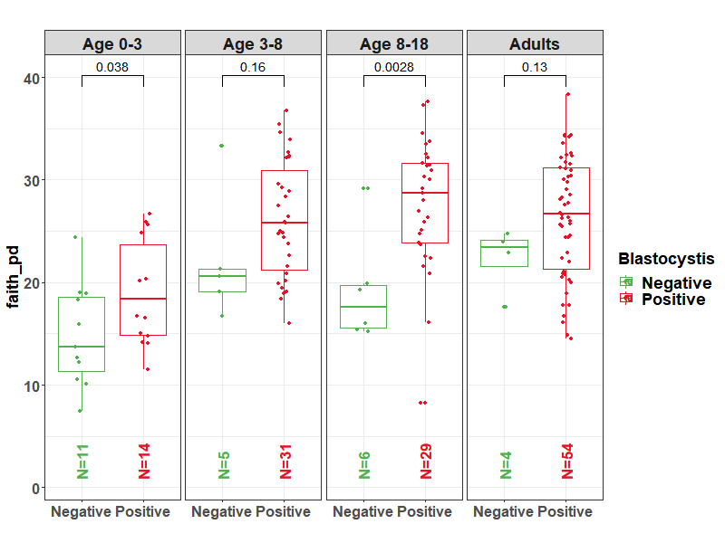
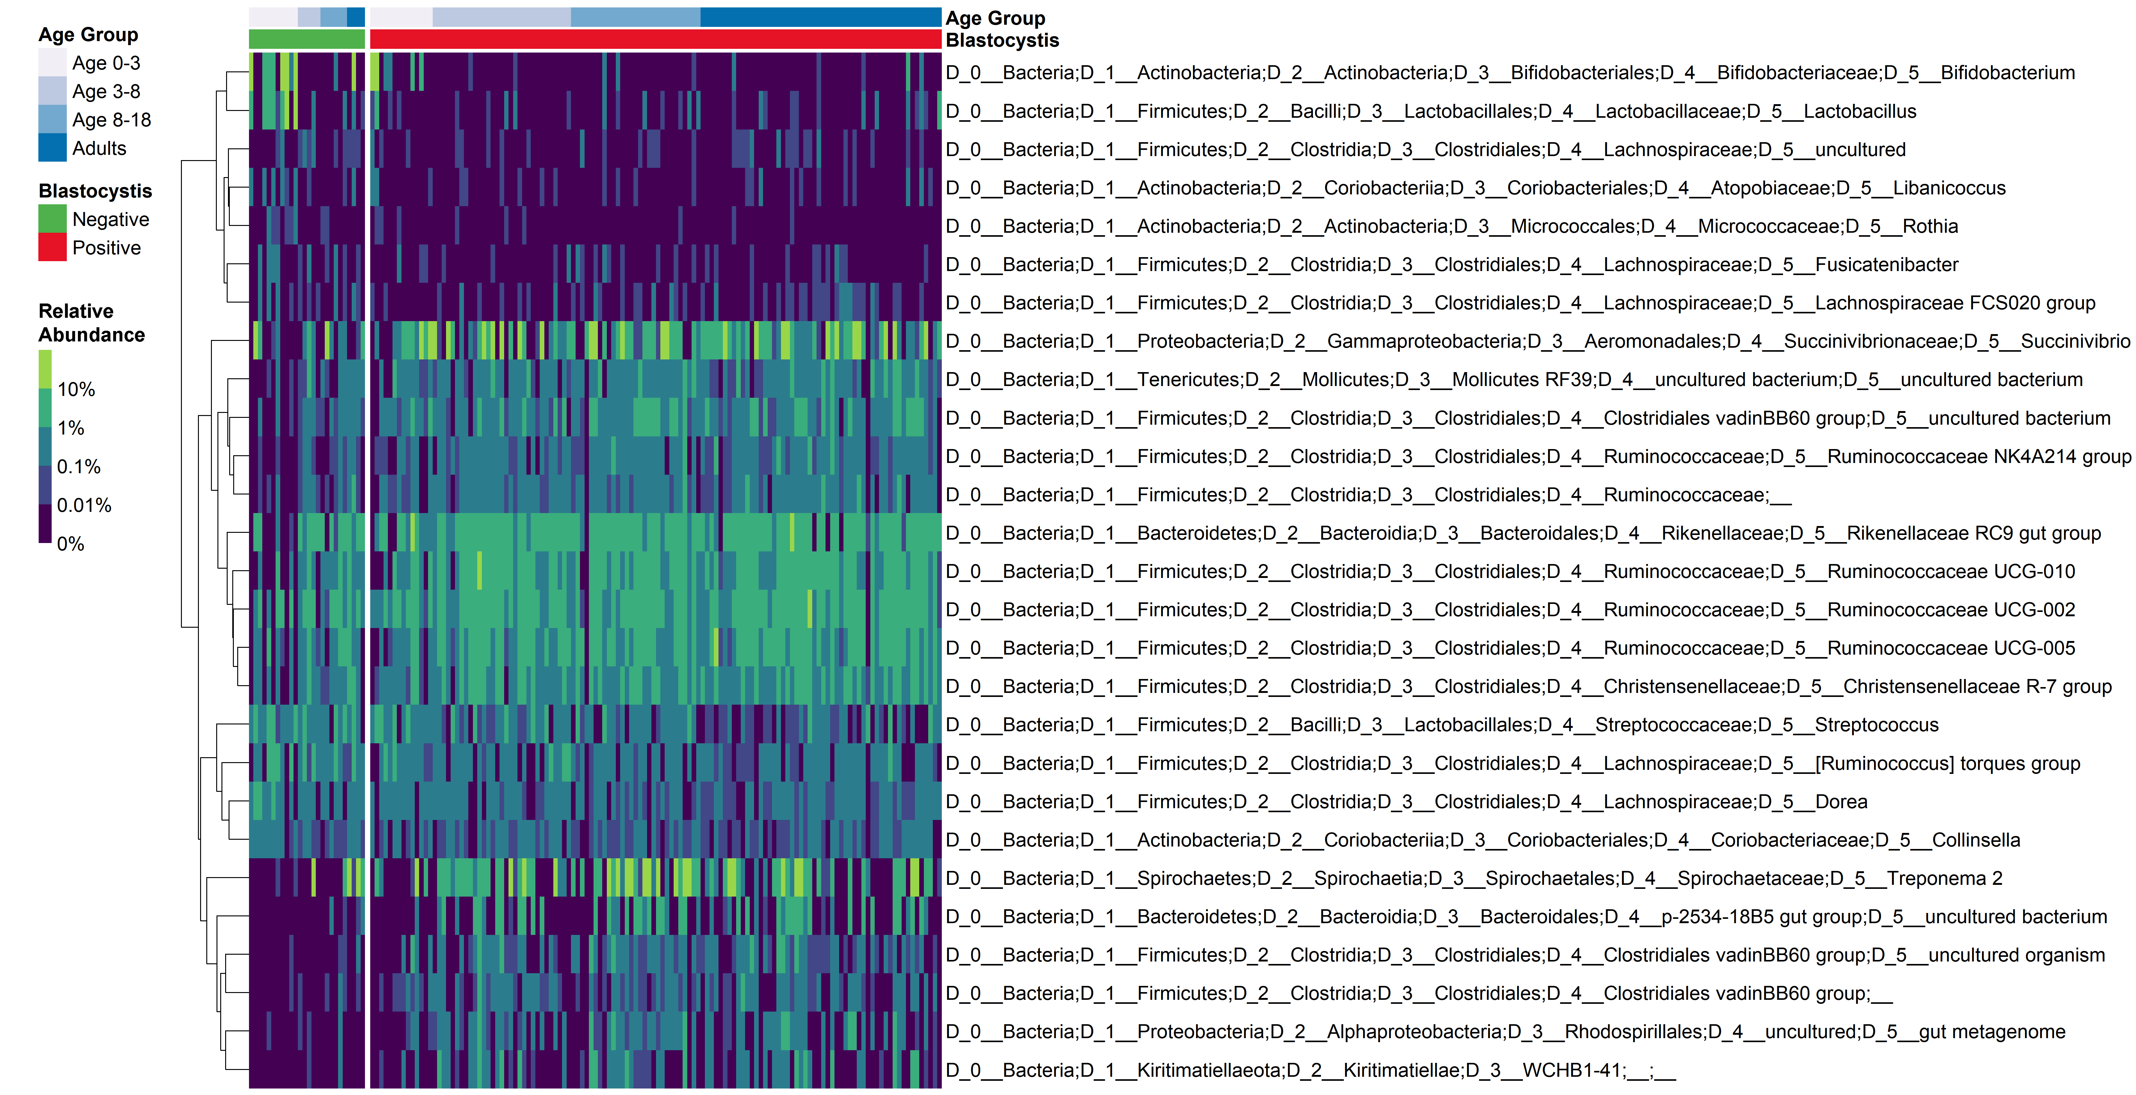
Fig 4. (A)Alpha diversity of fecal microbiota by Blastocystis status and age group. (B) Relative abundance of fecal bacteria that significantly differ by Blastocistis status
A
Alpha diversity tends to be higher in Blastocystis positive subjects, significant in the 0-3 and 8-18y age groups
B
Phylum | Order | Family | Genus | log2Ratio (Positive/Negative)
Actinobacteria | Bifidobacteriales | Bifidobacteriaceae | Bifidobacterium | -4.10
Firmicutes | Lactobacillales | Lactobacillaceae | Lactobacillus | -4.55
Firmicutes | Clostridiales | Lachnospiraceae | uncultured | -1.29
Actinobacteria | Coriobacteriales | Atopobiaceae | Libanicoccus | -1.91
Actinobacteria | Micrococcales | Micrococcaceae | Rothia | -3.35
Firmicutes | Clostridiales | Lachnospiraceae | Fusicatenibacter | -2.34
Firmicutes | Clostridiales | Lachnospiraceae | Lachnospiraceae FCS020 group | -1.71
Proteobacteria | Aeromonadales | Succinivibrionaceae | Succinivibrio | 1.64
Tenericutes | Mollicutes RF39 | uncultured bacterium | uncultured bacterium | 1.42
Firmicutes | Clostridiales | Clostridiales vadinBB60 group | uncultured bacterium | 2.14
Firmicutes | Clostridiales | Ruminococcaceae | Ruminococcaceae NK4A214 group | 2.31
Firmicutes | Clostridiales | Ruminococcaceae |  | 1.00
Bacteroidetes | Bacteroidales | Rikenellaceae | Rikenellaceae RC9 gut group | 0.97
Firmicutes | Clostridiales | Ruminococcaceae | Ruminococcaceae UCG-010 | 1.77
Firmicutes | Clostridiales | Ruminococcaceae | Ruminococcaceae UCG-002 | 0.85
Firmicutes | Clostridiales | Ruminococcaceae | Ruminococcaceae UCG-005 | 1.48
Firmicutes | Clostridiales | Christensenellaceae | Christensenellaceae R-7 group | 1.46
Firmicutes | Lactobacillales | Streptococcaceae | Streptococcus | -0.91
Firmicutes | Clostridiales | Lachnospiraceae | [Ruminococcus] torques group | -1.33
Firmicutes | Clostridiales | Lachnospiraceae | Dorea | -1.28
Actinobacteria | Coriobacteriales | Coriobacteriaceae | Collinsella | -0.84
Spirochaetes | Spirochaetales | Spirochaetaceae | Treponema 2 | 0.64
Bacteroidetes | Bacteroidales | p-2534-18B5 gut group | uncultured bacterium | 5.48
Firmicutes | Clostridiales | Clostridiales vadinBB60 group | uncultured organism | 4.16
Firmicutes | Clostridiales | Clostridiales vadinBB60 group |  | 3.85
Proteobacteria | Rhodospirillales | uncultured | gut metagenome | 4.19
Kiritimatiellaeota | WCHB1-41 |  |  | 4.15
Heatmap of relative abundance of the 27 taxa differing significantly with Blastocystis status. Each row represent a genus, each column represent a sample. Genus clustering was based on Euclidean distance using hclust (complete agglomeration method). Samples are arranged by Blastocystis status and age group. Font colors indicate higher (red) or lower (green) relative abundance in Blastocystis positive samples.

Slide 24
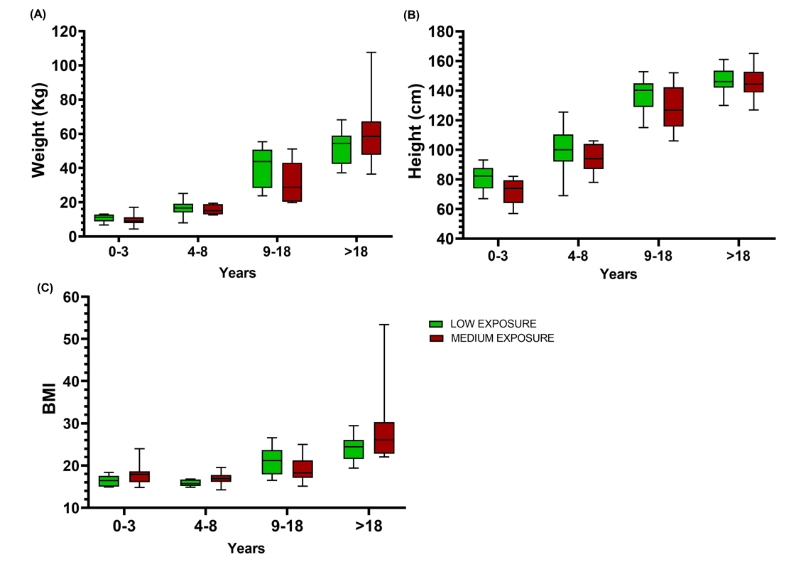
Figure x. Body morphometry from different exposure level during 2016.
Separate by gender!
BODY WEIGHT | N males | N females | Adjusted P Value
LOW - MEDIUM |  |  | males/females
0-3 |  | ns | 0.8595
4-8 |  | ns | 0.9798
9-18 |  | ns | 0.2540
>18 |  | ns | 0.3488
position=position_dodge(width=0.75)
HEIGHT | N | Summary | Adjusted P Value
LOW - MEDIUM
0-3 |  | ns | 0.2785
4-8 |  | ns | 0.5442
9-18 |  | ns | 0.1914
>18 |  | ns | 0.9887
BMI | N | Summary | Adjusted P Value
LOW - MEDIUM
0-3 |  | ns | 0.5376
4-8 |  | ns | 0.1299
9-18 |  | ns | 0.4774
>18 |  | ns | 0.1963
No significant difference in body morphometry was found in different exposure level.

Slide 25
Fig. 5A: Bray-Curtis distance for KEGG ortholog assignments – Amerindians exposure to Western medicine 2015
Permanova:
p = 0.001
Permanova:
p = 0.005

Slide 26
Fig 5A. Bray-Curtis distance for KEGG ortholog assignments – Amerindians exposure to Western medicine in 2016
Permanova:
p = 0.35
Permanova:
p = 0.96

Slide 27
Fig. 5B: Bray-Curtis distance for KEGG ortholog assignments – Amerindians compared to Western microbiomes 2015
Permanova:
p = 0.001
Permanova:
p = 0.001
Notes:
Batch effects
Differences with western is biger than our batch effect

Slide 28
Fig 5B. Bray-Curtis distance for KEGG ortholog assignments – Amerindians compared to Western microbiomes in 2016
Permanova:
p = 0.001
Permanova:
p = 0.001

Slide 29
Fig 5C.2015
Higher values =
greater
abundance
in
Western

Slide 30
Fig 5C.2016

Slide 31
Higher values =
greater
abundance
in
MediumUrban

Slide 32
Fig5D. - Beta-lactam KEGG ortholog abundance changes 2015

Slide 33
Fig5D. - Beta-lactam KEGG ortholog abundance changes in 2016

Slide 34
Parasite burden by village, 2015
Parasite Type | Chajuranha |  | Kanarakuni |  | Mosenahanha
 | N | n (%) | N | n (%) | N | n (%)
Onchocerca | 0 | - | 0 | - | 0 | -
Ancylostomide eggs | 25 | 12 (48.0) | 57 | 17 (29.8) | 6 | 3 (50.0)
Ascaris lumbricoides eggs | 25 | 10 (40.0) | 57 | 19 (33.3) | 6 | 0 (0)
Trichuris trichiura eggs | 25 | 1 (4.0) | 57 | 0 (0) | 6 | 0 (0)
Giardia lamblia cysts | 25 | 2 (8.0) | 57 | 8 (14.0) | 6 | 0 (0)
Giardia lamblia trofozoites | 27 | 1 (3.7) | 56 | 0 (0) | 6 | 0 (0)
Blastocystis spp. | 25 | 3 (12.0) | 57 | 11 (19.3) | 6 | 0 (0)
Iodamoeba butschlii cysts | 25 | 3 (12.0) | 57 | 2 (3.5) | 6 | 2 (33.3)
Endolimax nana cysts | 25 | 10 (40.0) | 57 | 25 (43.9) | 6 | 2 (33.3)
Entamoeba histolytica/dispar | 25 | 6 (24.0) | 57 | 11 (19.3) | 6 | 2 (33.3)
Entamoeba histolytica trofozoites | 25 | 14 (56.0) | 57 | 19 (33.3) | 6 | 3 (50.0)
Entamoeba coli cysts | 27 | 0 (0) | 57 | 2 (3.5) | 6 | 0 (0)
Entamoeba coli trofozoites | 27 | 0 (0) | 57 | 1 (1.8) | 6 | 0 (0)
Chilomastix mesnili cysts | 25 | 3 (12.0) | 57 | 19 (33.3) | 6 | 1 (16.7)
Enterobius vermicularis eggs | 27 | 0 (0) | 57 | 0 (0) | 6 | 0 (0)
Hymenolepis nana eggs | 27 | 0 (0) | 57 | 3 (5.3) | 6 | 0 (0)
Dientamoeba fragilis cyst | 27 | 0 (0) | 57 | 0 (0) | 6 | 0 (0)
Strongyloides stercolaris larvas | 27 | 0 (0) | 57 | 0 (0) | 6 | 0 (0)

Slide 35
Parasite burden by village, 2016
Parasite Type | Chajuranha |  | Fiyakwanha |  | Kanarakuni |  | Kuyuwininha |  | Shianana |  | Sudukuma |  | Washudihanha
 | N | n (%) | N | n (%) | N | n (%) | N | n (%) | N | n (%) | N | n (%) | N | n (%)
Onchocerca | 0 | - | 0 | - | 0 | - | 32 | 25 (78.1) | 0 | - | 0 | - | 0 | -
Ancylostomide eggs | 10 | 4 (40.0) | 44 | 27 (61.4) | 44 | 15 (34.1) | 32 | 8 (25.0) | 19 | 8 (42.1) | 22 | 6 (27.3) | 3 | 1 (33.3)
Ascaris lumbricoides eggs | 10 | 7 (70.0) | 44 | 15 (34.1) | 44 | 17 (38.6) | 32 | 2 (6.3) | 19 | 16 (84.2) | 22 | 9 (40.9) | 3 | 2 (66.7)
Trichuris trichiura eggs | 10 | 1 (10.0) | 44 | 12 (27.3) | 44 | 0 (0) | 32 | 0 (0) | 19 | 6 (31.6) | 22 | 2 (9.1) | 3 | 0 (0)
Giardia lamblia cysts | 10 | 0 (0) | 44 | 1 (2.3) | 44 | 5 (11.4) | 32 | 6 (18.8) | 19 | 1 (5.3) | 22 | 3 (13.6) | 3 | 0 (0)
Giardia lamblia trofozoites | 10 | 1 (10.0) | 44 | 0 (0) | 43 | 0 (0) | 32 | 4 (12.5) | 19 | 0 (0) | 22 | 1 (4.5) | 3 | 0 (0)
Blastocystis spp. | 10 | 3 (30.0) | 44 | 5 (11.4) | 44 | 9 (20.5) | 32 | 9 (28.1) | 19 | 3 (15.8) | 22 | 5 (22.7) | 3 | 0 (0)
Iodamoeba butschlii cysts | 10 | 2 (20.0) | 44 | 1 (2.3) | 44 | 0 (0) | 32 | 3 (9.4) | 19 | 4 (21.1) | 22 | 5 (22.7) | 3 | 0 (0)
Endolimax nana cysts | 10 | 4 (40.0) | 44 | 12 (27.3) | 44 | 18 (40.9) | 32 | 0 (0) | 19 | 8 (42.1) | 22 | 15 (68.2) | 3 | 1 (33.3)
Entamoeba histolytica/dispar | 10 | 0 (0) | 44 | 1 (2.3) | 44 | 7 (15.9) | 32 | 13 (40.6) | 19 | 1 (5.3) | 22 | 5 (22.7) | 3 | 0 (0)
Entamoeba histolytica trofozoites | 10 | 9 (90.0) | 44 | 16 (36.4) | 44 | 16 (36.4) | 32 | 2 (6.3) | 19 | 11 (57.9) | 22 | 18 (81.8) | 3 | 0 (0)
Entamoeba coli cysts | 10 | 0 (0) | 44 | 0 (0) | 44 | 2 (4.5) | 32 | 0 (0) | 19 | 0 (0) | 22 | 1 (4.5) | 3 | 0 (0)
Entamoeba coli trofozoites | 10 | 0 (0) | 44 | 0 (0) | 44 | 1 (2.3) | 32 | 1 (3.1) | 19 | 1 (5.3) | 22 | 3 (13.6) | 3 | 0 (0)
Chilomastix mesnili cysts | 10 | 3 (30.0) | 44 | 4 (9.1) | 44 | 19 (43.2) | 32 | 1 (3.1) | 19 | 1 (5.3) | 22 | 9 (40.9) | 3 | 0 (0)
Enterobius vermicularis eggs | 10 | 0 (0) | 44 | 0 (0) | 44 | 0 (0) | 32 | 2 (6.3) | 19 | 0 (0) | 22 | 1 (4.5) | 3 | 0 (0)
Hymenolepis nana eggs | 10 | 0 (0) | 44 | 2 (4.5) | 44 | 3 (6.8) | 33 | 0 (0) | 19 | 0 (0) | 22 | 2 (9.1) | 3 | 0 (0)
Dientamoeba fragilis cyst | 10 | 0 (0) | 44 | 0 (0) | 44 | 0 (0) | 0 | - | 19 | 0 (0) | 22 | 0 (0) | 3 | 0 (0)
Strongyloides stercolaris larvas | 10 | 0 (0) | 44 | 0 (0) | 44 | 0 (0) | 0 | - | 19 | 0 (0) | 22 | 1 (4.5) | 3 | 0 (0)

